Slide 1





Dollar Street
Where do you live?

Slide 2




WHO IS AFFECTED BY INEQUALITY?
Class 1: What is inequality?

Slide 3




What is dollar street about?

Slide 4



Two activities
One website
You are going to participate in two different activities to engage in discussion about inequality and what it looks like around the world.
You will have two classes to learn about and explore Dollar Street, and to find out about how inequality isn’t about where we live - it’s about what economic opportunities people have.

Slide 5




Your first task
What does inequality look like?

Slide 6

Living conditions on four income levels
Imagine all the homes in the world lined up on one long street, sorted by income. The poorest live at the left and the riches live at the right. Everybody else/ Most live somewhere in the middle. Your house number on this street represents your income. Your neighbours on Dollar Street are people from all over the world, with the same income as you.
Where do you think you live?

Slide 7
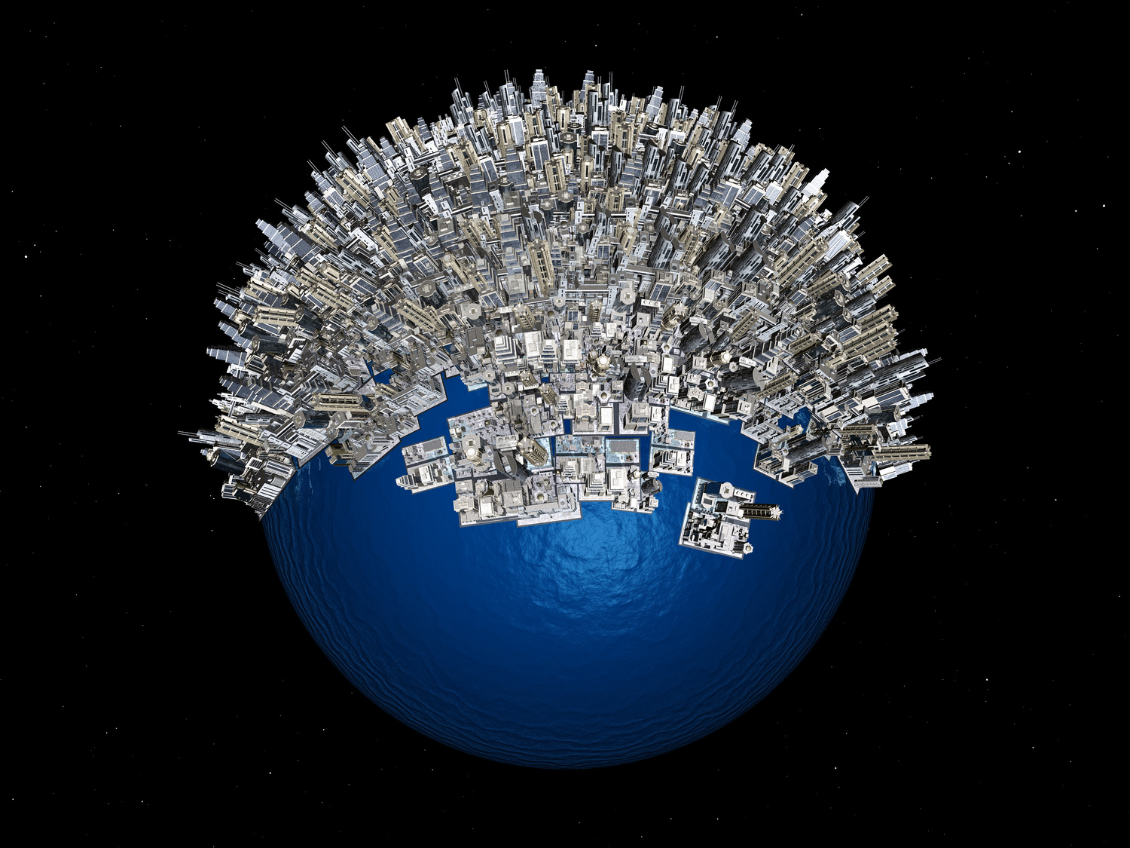


The world
The world has 7 billion people (2020)
There are four income levels that people live on:
Level 1: One billion people
Level 2: Three billion people
Level 3: Two billion people
Level 4: One billion people

Slide 8
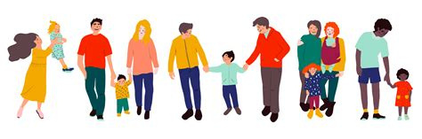


Your first task
You will get 21 different pictures to sort
Each group of pictures shows how people satisfy three basic needs:
Housing
Food
Water
You will need to sort them from the poorest to the richest, in order and by each basic need.
When analyzing, look for...
Housing: houses should protect people against the elements. Look for a houses’ stability and how well it might protect inhabitants from wind, water, heat, and/or cold
Water: Should be to drink, bathe and wash clothes. It should be free from bacteria to be clean. What do the pictures say about people’s access to it and how near a secure water source is?
Food: Meals should provide enough calories and nutrition. How many ingredients do they have in the food and how much protein?

Slide 9
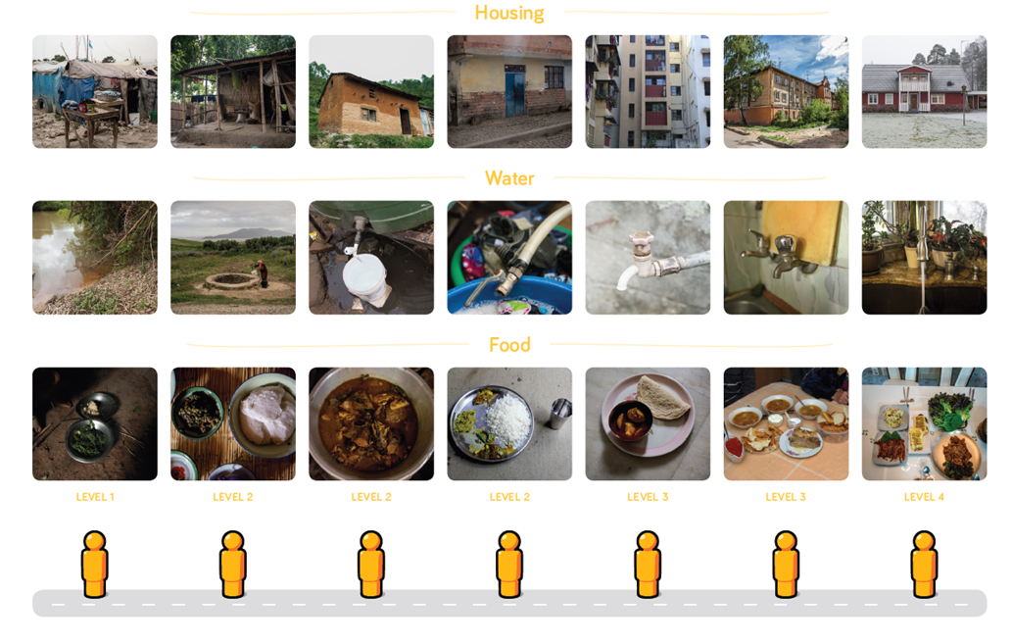
Did your order match this one?
Discuss
What are the differences in living conditions that you noticed?
How do living conditions differ between the riches and the poorest?
Are there any small changes in between?

Slide 10
Did your order match this one?
Discuss
What are the differences in living conditions that you noticed?
How do living conditions differ between the riches and the poorest?
Are there any small changes in between?

Slide 11
Did your order match this one?
Discuss
What are the differences in living conditions that you noticed?
How do living conditions differ between the riches and the poorest?
Are there any small changes in between?

Slide 12
Class 2: Your second task
Dive deeper into inequality

Slide 13


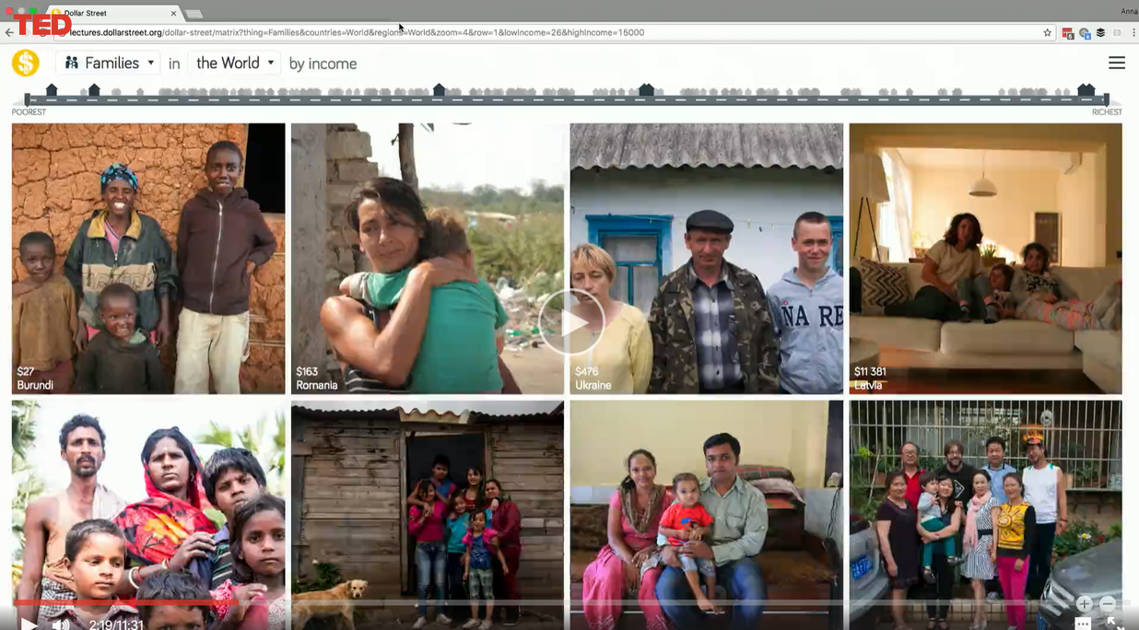

Watch...
This video is going to explain the website you’ll be visiting
Don’t worry if you don’t catch everything in this video. What you should take away is:
(1) how to use the website - buttons and tabs to use
(2) what the website is trying to show you
(3) why they use pictures to show you differences around the world

Slide 14

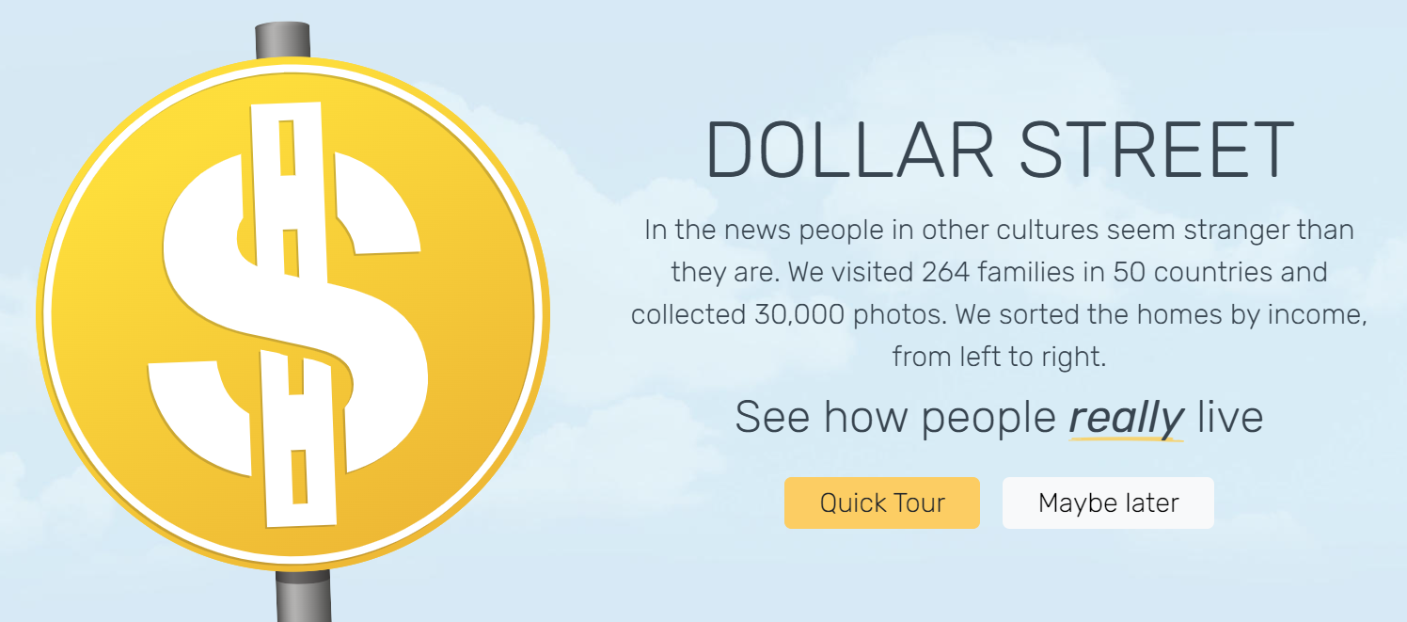


The Website
Let’s look at the most important things on the website...
When you open it, take the quick tour

Slide 15
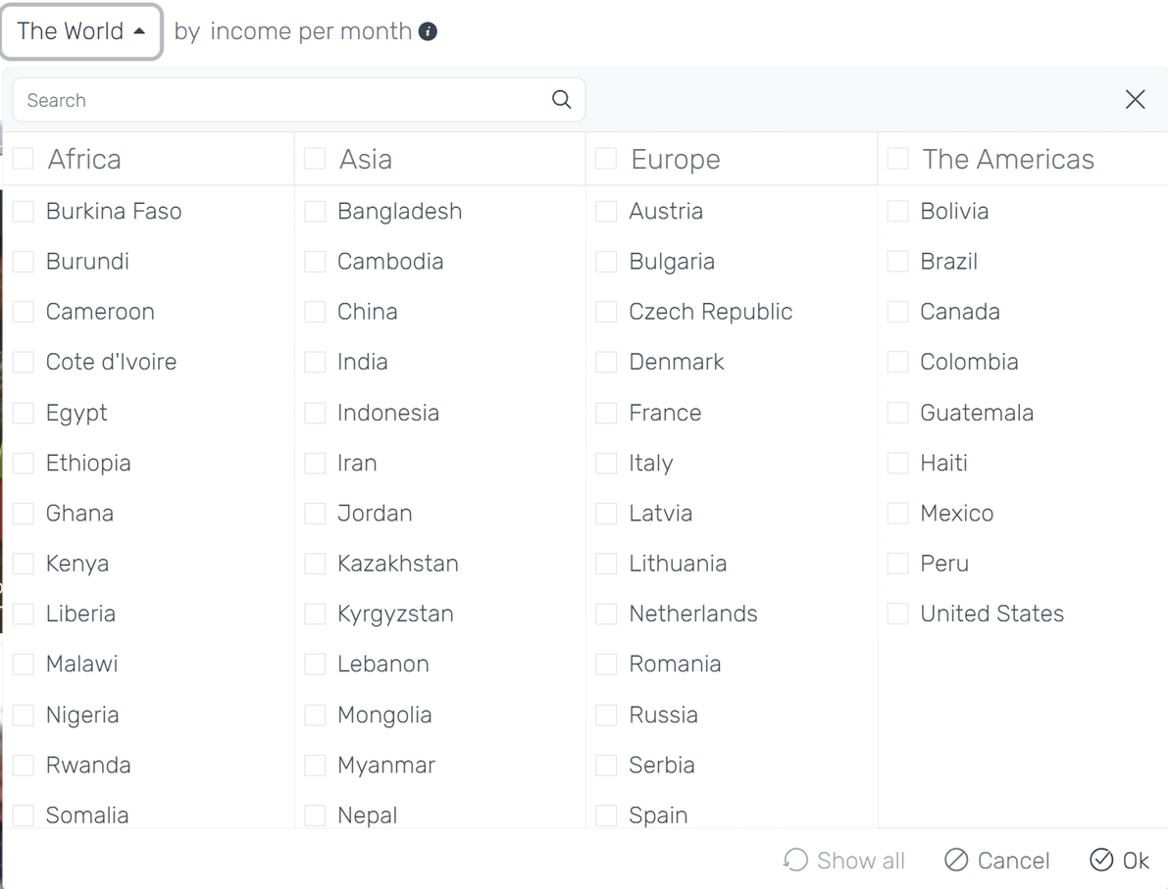
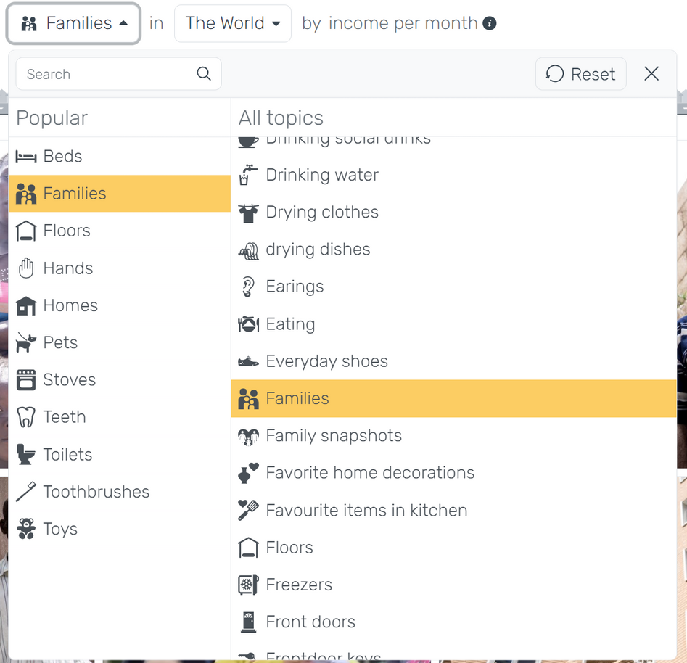

The Website
Notice these tabs, so you can explore different items and countries

Slide 16
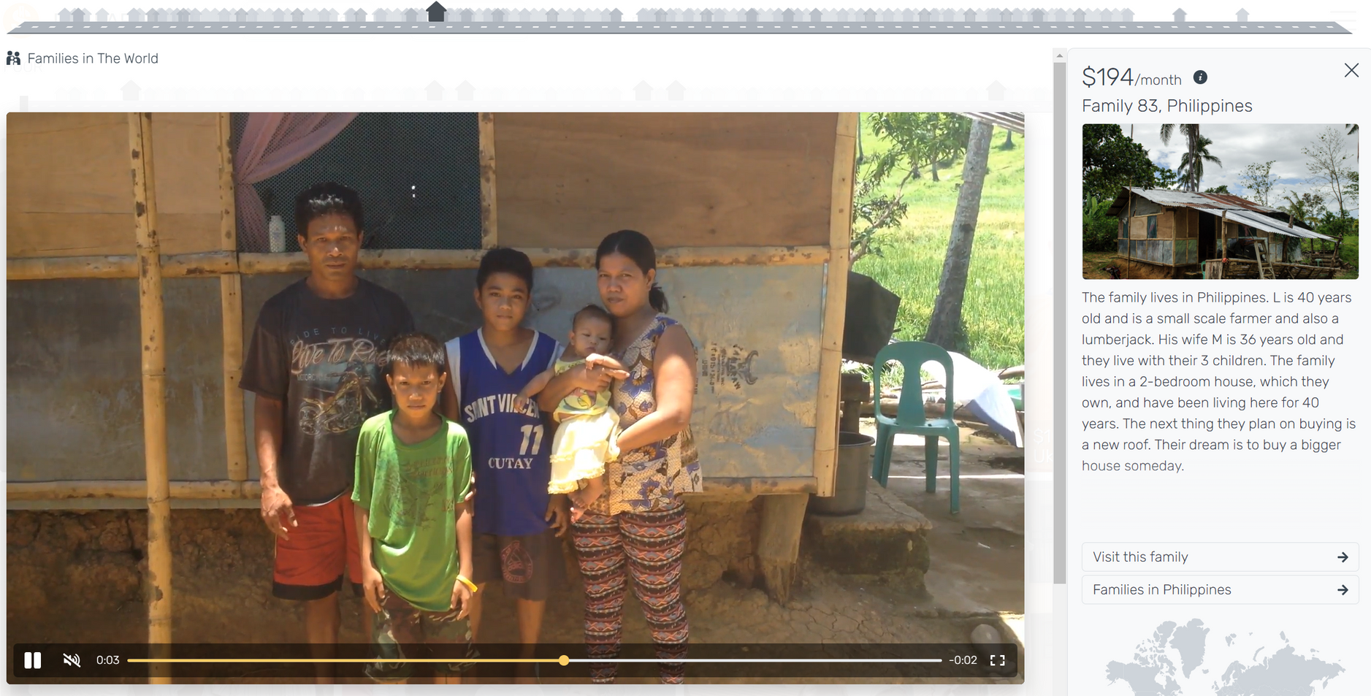
The Website
You can also click on any of these houses to see other incomes. If you click near the house that is dark, you will see other families in the same income area
When you click on a family or an item from the main page, you see this...
You can click here to see all the categories of this particular family
Or you can click here to see different from the same category

Slide 17





Let’s explore
Can you find an example of a family who has an income between $20-$100?
Scroll down your screen to get different houses to pop up, then hover over the black houses to see the income range.
Once you choose a house, read the description. Then, you will visit that family and share with a partner. What do you see that is the same? Different?
If you hover over the pictures, the video will play.
You can either click ‘reset’ or click the Dollar Street sign on the top left corner to reset your street

Slide 18
What do you notice about a house of this income?
$20-$100
Is there a relationship between income and:
  health
  family size
  occupation
  transportation
  electronics/technology
  housing/living conditions
You can either click ‘reset’ or click the Dollar Street sign on the top left corner to reset your street

Slide 19
Let’s explore
Can you find an example of a family who has an income between $500-$1,500?
Scroll down your screen to get different houses to pop up, then hover over the black houses to see the income range.
Once you choose a house, read the description. Then, you will visit that family and share with a partner. What do you see that is the same? Different?
If you hover over the pictures, the video will play.
You can either click ‘reset’ or click the Dollar Street sign on the top left corner to reset your street

Slide 20
What do you notice about a house of this income?
$500-$1,500
Is there a relationship between income and:
  health
  family size
  occupation
  transportation
  electronics/technology
  housing/living conditions
You can either click ‘reset’ or click the Dollar Street sign on the top left corner to reset your street

Slide 21
Let’s explore
Can you find an example of a family who has an income between $5,000-$10,000?
Scroll down your screen to get different houses to pop up, then hover over the black houses to see the income range.
Once you choose a house, read the description. Then, you will visit that family and share with a partner. What do you see that is the same? Different?
If you hover over the pictures, the video will play.
You can either click ‘reset’ or click the Dollar Street sign on the top left corner to reset your street

Slide 22
What do you notice about a house of this income?
$5,000-$10,000
Is there a relationship between income and:
  health
  family size
  occupation
  transportation
  electronics/technology
  housing/living conditions
You can either click ‘reset’ or click the Dollar Street sign on the top left corner to reset your street

Slide 23
Let’s explore
Can you find an example of a family who has an income between $10,000+?
Scroll down your screen to get different houses to pop up, then hover over the black houses to see the income range.
Once you choose a house, read the description. Then, you will visit that family and share with a partner. What do you see that is the same? Different?
If you hover over the pictures, the video will play.
You can either click ‘reset’ or click the Dollar Street sign on the top left corner to reset your street

Slide 24
What do you notice about a house of this income?
$10,000
Is there a relationship between income and:
  health
  family size
  occupation
  transportation
  electronics/technology
  housing/living conditions
You can either click ‘reset’ or click the Dollar Street sign on the top left corner to reset your street

Slide 25

Discuss
How do the lives and living conditions of those with the same income level compare across the world? For example, how do the lives of those living on $1,000/month compare in India, France, Colombia, Egypt, Indonesia, and the United States?
Is there a relationship between income and a family’s/dreams?

Slide 26
Discuss
Do you think what someone considers to be a ‘need’ vs a ‘want’ changes depending on their income? Do you think someone’s definition might depend on where they live?
Do you think education is a need or want?
How did comparing the lives of these families make you feel?

Slide 27
Class 3:
Let’s reflect
What is inequality about?
Watch this video

Slide 28






How can you be fair and help to reduce inequalities? Check out the Good Life Goals!
How you or grown ups can take action to help the Sustainability Development goals
What to learn about it
How you can take action
Remember, the Sustainability Development Goals (SDGs) are how nations or countries take action. The Good Life Goals are how citizens (like you and me) take action!

Slide 29
reflect on what you have learned... what does it all mean?
In pairs, groups, or individually you will answer questions about Dollar Street and inequality.
(1) You must answer all questions in complete sentences
(2) It doesn’t matter if you are in teams or not, each person must have their own answers
(3)You must finish all questions and put it in your folder

Slide 30
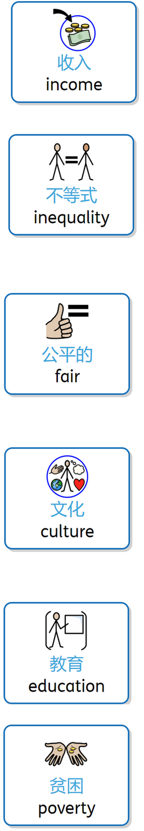
Let’s look at the questions..
  What is income inequality (收入不平等), and why should we learn about it?
  Did you notice families on Dollar Street with different amounts of money (钱)? How were their lives different, and what does this teach us?
  Why do some people have more money (钱) than others, even if they are from the same country (国家)?
  Why is it important to help people who have less money (钱) than us, and how can we make the world (世界) more fair (公平) for everyone?
  How can we make sure everyone has enough money (钱) to live well, no matter where they're from (来自哪里) or what they look like (长什么样)?
  Why is education (教育) important when talking about money (钱) and income (收入)?
  What shows that poverty (贫穷) is more about how much money (钱) people have, not where they come from (来自哪里)?

